Slide 1
Project 4
Movies Recommendation System
Andrea Brown
Belinda Oshomuvwe
Endy Mateo

Slide 2

Objective
Enhance user experience
Reduce decision time
Improve user retention
Notes:
In summary, our project aims to leverage content-based filtering techniques to develop a movie recommendation system that enriches user experience, reduces decision time, and fosters platform retention. By prioritizing personalization and relevance, we aspire to create a movie-watching journey that is not only enjoyable but also effortless for users.

Slide 3
About our data
IMDB Dataset of 1,000 top Movies and Tv shows
15 Columns / 1,000 Rows
Meta Data Available: Title , Release year, Certificate, Run time, Genre, IMDB Rating, Overview, Meta Score, Director, Stars 1 - 4, NO. Votes, Gross $
Clean Data set

Slide 4
Data Model Implementation
Mural Learning
Visualize: Create visual diagrams ( Tableau & Linear regression) to represent our data model and processes.
Collaborate: Team members contribute insights and annotations to the mural, fostering shared understanding.
Optimize: Use murals to identify inefficiencies and refine our data model iteratively.
By employing mural learning techniques, we enhance collaboration, understanding, and optimization in our data modeling process.
Model performance metric is based on accuracy

Slide 5
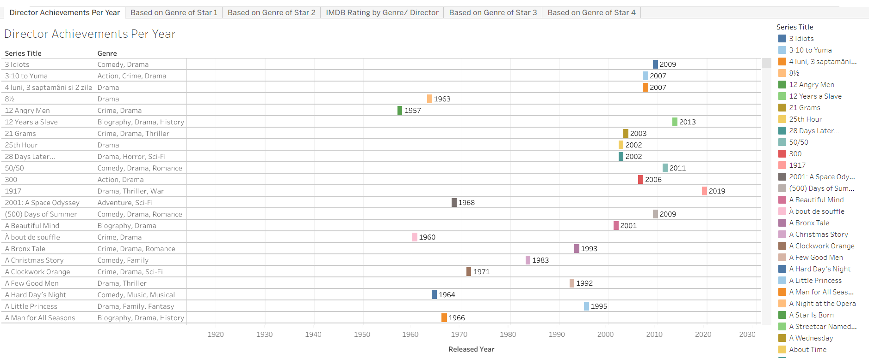
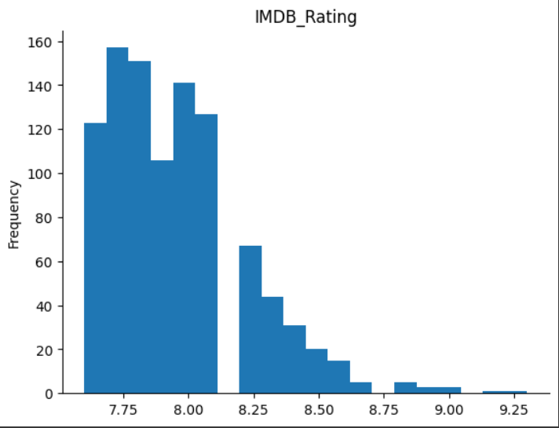
Visualizations
Tableau (6)

Slide 6
Model Optimization / K-Mean
Model optimization using K-means clustering enhances the performance and interpretability of machine learning models, making them more effective in various applications.
-Best value for K is 4

Slide 7
Conclusion
The objective is to construct a movie recommendation system that predicts movies to watch based on viewers' history. The movie recommend system will notice a movie based on past viewing history, and select a movie with a high correlation, high rating and high rating count. A movie with a high correlation, high rating and high rating count is predicted a good movie to watch. The movie recommends type is content-based filtering and it suggests similar items based on a particular item. This system uses item metadata, such as genre, ratings, director, description, actors, etc. for movies, to make these recommendations. The general idea behind this recommender system is that if a person likes a particular item, he or she will also like an item that is similar to it.

Slide 8
Questions ?

